Slide 1
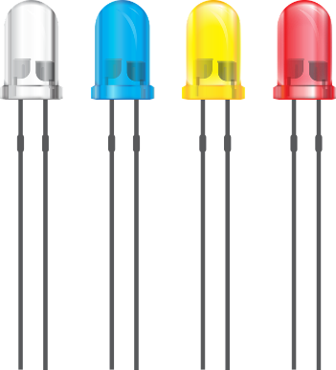
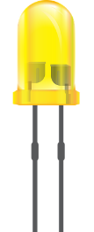
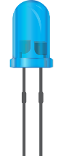
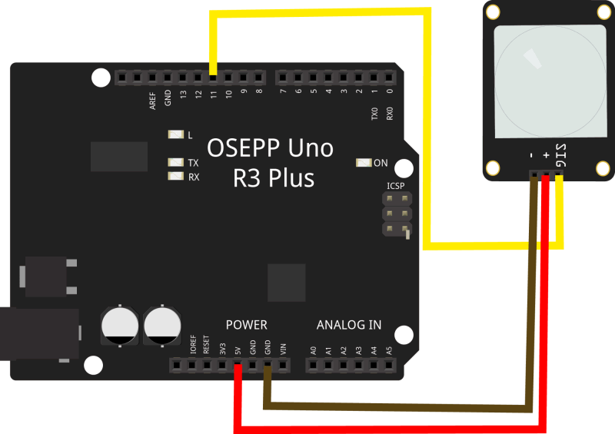
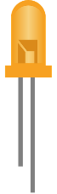
Led is connected
to pin 13 and is
for the sound alarm
Led is connected
to pin 9 and is
for when the door
is unlocked/locked
Led is connected
to pin 2 and is for visual
warning signal (SOS distress
signal)
Led is connected
to pin 6 and is when
the sensor is
switched on/off

